Slide 1
DIGITAL MARKETING
INTERNSHIP COMPRESSIVE DIGITAL MARKETING FOR
AMUL
PROJECT REPORT ON AMUL UNDER THE ESTEEMED GUIDANCE OF
K.RATNA KUMARI MADAM
PRESENTED BY
Annem Bhavani Shankar
Reg No: 213888200006
SRI VASAVI DEGREE COLLEGE

Slide 2

INTERNSHIP
COMPREHENSIVE DIGITAL MARKETING FOR AMUL
TEAM MEMBER:
NAME: ANNEM BHAVANI SHANKAR
EMAIL:Annembhavanishankar
REG.No:213888200006
PHONE NO:6281376886

Slide 3





TEAM LEADER
NAME : SIVA SAI KRISHNA
E-MAIL : suryamadicharla63@gmail.com
REG NO : 213888200049
PH.NO : 9346912475
TEAM MEMBER 1
TEAM MEMBER 2
TEAM MEMBER 3
TEAM MEMBER 4
NAME : Kasukurthi suresh
E-MAIL :
kasukurthisuresh123@gmail.com
REG NO : 213888200040
PH.NO : 6304063080
NAME : Vase Akshay Kumar
E-MAIL : Vase75@gmail.com
REG NO : 213888200084
PH.NO : 6301779975
NAME : Gobbilla Sai Krishna
E-MAIL: gsaikrishna215@gmail.com
REG NO : 213888200027
PH.NO : 9989199125
NAME : Annem Bhavani Shankar
E-MAIL: Annembhavanishankaer24@gmail.com
REG NO : 213888200006
PH.NO : 6281376886

Slide 4
Table of contents
1.Brand study , competitor analysis & buyer’s audiences’s Persnol
2.Seo & keywords research
3.Content ideas and marketing strategies
4.Content creation and curation

Slide 5
AMUL
Adikavi Nannaya University
Team lead(Madicharla Siva Sai Krishna)
Team Members :
1.Member 1 ( Madicharla Siva Sai Krishna )
2. Member 2 ( Kasukurthi suresh )
3. Member 3 ( Akshay Kumar vase )
4. Member 4 ( Gobbila Sai Krishna )
5. Member 5 ( Annem Bhavani Shankar )

Slide 6
Amul brand research values
Amul, as a brand, values quality, innovation, sustainability, and a commitment to serving its customers. They focus on providing affordable and nutritious dairy products while also supporting local farmers and communities. Their research likely aligns with these values, emphasizing product development, market analysis, and customer satisfaction

Slide 7
Analyze Brand Tone and Identity:
Tone: Amul's brand tone is typically friendly, relatable, and sometimes humorous. They often use witty and creative advertising campaigns to engage with their audience. This tone helps them connect with consumers on a personal level while also conveying their brand values of quality, affordability, and community support.
Identity: Amul's brand identity revolves around being a trustworthy provider of dairy products. They emphasize their cooperative model, which highlights their commitment to supporting local farmers and delivering fresh, high-quality products. Their identity also includes elements of innovation, as they continually introduce new products and flavors to meet consumer demands. Overall, Amul's brand identity is rooted in tradition, quality, and affordability

Slide 8
Set 4 SMART goals and KPIs for the same:
Four SMART goals along with their corresponding Key Performance Indicators (KPIs) for Amul:
1.Goal: Increase market share in the dairy industry by 10% within the next fiscal year.
KPI: Percentage increase in market share compared to competitors.
2. Goal: Improve customer satisfaction by enhancing product quality and customer service, aiming for a 15% increase in customer retention rate.
KPI: Customer retention rate (% of customers retained over a specific period).
3. Goal: Expand product distribution to new regions by entering into partnerships with local retailers and distributors, aiming to establish presence in 20 new cities within the next two years.
KPI: Number of new cities penetrated within the target timeframe.
4. Goal: Reduce environmental footprint by implementing sustainable practices across the supply chain, aiming for a 20% reduction in carbon emissions by 2025.
KPI: Percentage decrease in carbon emissions compared to the baseline year
These goals are Specific, Measurable, Achievable, Relevant, and Time-bound, making them SMART and effective for guiding Amul's strategic initiatives.

Slide 9
Brand study (Mission/Values & USP)
Mission/Values:
Mission: Amul's mission revolves around providing high-quality dairy products while supporting local farmers and promoting sustainability.
Values:
● Quality: Commitment to delivering fresh and nutritious dairy products.
● Community: Support for local farmers through the cooperative model.
● Innovation: Continual improvement and introduction of new products to meet consumer needs.
● Affordability: Ensuring products are accessible to a wide range of consumers.
● Sustainability: Implementing eco-friendly practices across the supply chain to reduce environmental impact.
Unique Selling Proposition (USP):
● Cooperative Model: Amul's USP lies in its cooperative structure, involving millions of farmers who collectively own the brand. This ensures the quality and freshness of products while also empowering local agricultural communities.
● Affordability: Offering high-quality dairy products at competitive prices, making them accessible to a diverse customer base.
● Wide Product Range: Amul's diverse portfolio includes milk, butter, cheese, ice cream, and other dairy products, catering to various consumer preferences.
● Iconic Advertising: Leveraging creative and often humorous advertising campaigns, Amul has established a unique brand identity and emotional connection with consumers.

Slide 10
Brand study (Brand Tone & KPI)
Brand Tone:
● Friendly & Relatable: Amul's brand tone is often characterized by its friendly and relatable communication style, which resonates with consumers across demographics.
● Witty & Humorous: The brand is known for its witty and humorous advertising campaigns, which use clever wordplay and topical references to engage audience
● Authentic & Trustworthy: Amul's communication conveys authenticity and trustworthiness, reflecting its commitment to quality and transparency.
Key Performance Indicators (KPIs):
● Brand Awareness: Measure of the brand's visibility and recognition among the target audience through surveys, social media mentions, and website traffic.
● Customer Engagement: Quantify the level of interaction and engagement with the brand across various channels, including social media likes/shares, comments, and email open rates.
● Advertising Effectiveness: Assess the impact of advertising campaigns on brand perception and consumer behavior, measured by ad recall, brand sentiment analysis, and sales uplift.
● Customer Satisfaction: Gauge customer satisfaction levels through feedback surveys, Net Promoter Score (NPS), and online reviews to ensure alignment with brand values and service quality.
● Market Share: Track the brand's share of the market compared to competitors, indicating its position and competitiveness within the industry

Slide 11
Buyer/Audience Personal
Demographic Information
Psychographic Information:
Name: Priya Patel
Age: 32
Gender: Female
Occupation: Marketing Manager
Income Level: Middle to upper-middle class
Location: Urban or suburban area in India
Lifestyle: Busy professional with a hectic
Work scheduleValues: Health-conscious, seeks convenience and quality in food choices
Interests: Cooking, trying new recipes, staying updated on food trends
Pain Points: Limited time for grocery shopping, desires healthy and tasty meal options.
Behaviors:
Regularly shops at supermarkets and online grocery stores for convenience
Prefers brands that offer a balance of quality, affordability, and convenience
Actively engages with social media platforms for recipe inspiration and food-related content

Slide 12
Goals and Motivations:
Wants to maintain a healthy lifestyle despite a busy schedule
Seeks quick and nutritious meal solutions for herself and her family
Values brands that align with her health and sustainability values
How Amul Fits into Priya's Life:
Priya sees Amul as a trusted brand for high-quality dairy products that she can incorporate into her daily meals.
She appreciates Amul's wide range of offerings, including milk, cheese, yogurt, and butter, which provide versatility in her cooking.
Amul's emphasis on affordability and accessibility makes it a convenient choice for Priya when shopping for groceries online or in-store.

Slide 13
Part 1: Brand study, Competitor Analysis & Buyer’s/Audience’s Personal
Competitor Analysis:
Competitor 1: Mother Dairy
Mission/Values: Similar to Amul, with a focus on providing quality dairy products and supporting local farmers.
USP: Strong distribution network, emphasis on freshness, and competitive pricing.
Brand Tone & Identity: Professional, trustworthy, and focused on health and nutrition.
Competitor 2: Nestle
Mission/Values: Emphasis on nutrition, sustainability, and innovation.
USP: Diverse product portfolio beyond dairy, global presence, and focus on health and wellness.
Brand Tone & Identity: Corporate, innovative, and health-conscious.

Slide 14
Competitor 1: Mother Dairy
Mission/Values: Mother Dairy focuses on providing fresh, nutritious, and affordable dairy products to consumers while supporting local farmers and promoting sustainability.
USP: Strong emphasis on freshness and quality, wide distribution network, and commitment to supporting dairy farmers through its cooperative model.
Brand Tone & Identity: Professional, trustworthy, and health-conscious, with a focus on freshness and purity.
Online communication:
Mother Dairy engages consumers through diverse online channels. Social media platforms showcase engaging content like recipe videos and nutritional tips, fostering community interaction. Their website hosts informative blogs on dairy nutrition and sustainable farming. Personalized email newsletters deliver updates and promotions. Collaborations with influencers and targeted online ads amplify brand visibility. By encouraging customer reviews and participating in online forums, Mother Dairy builds trust and connects with its audience in the digital realm.

Slide 15
SWOT
Strengths
Weaknesses
Strong Brand Equity: Mother Dairy is a well-established and trusted brand with a long history of providing high-quality dairy products to consumers.
Wide Product Portfolio: The brand offers a diverse range of dairy products including milk, yogurt, cheese, ice cream, and butter, catering to various consumer
Preferences Cooperative Model: Mother Dairy's cooperative model involves working closely with local dairy farmers, ensuring a consistent and fresh supply of milk while supporting rural livelihoods.
Dependence on Dairy: Mother Dairy's heavy reliance on dairy products makes it vulnerable to fluctuations in milk production and market demand.
Limited Innovation: Compared to competitors, the brand may have limited innovation in terms of new product development and packaging, potentially hindering its ability to capture new market segments.
Regional Concentration: While Mother Dairy has a strong presence in certain regions, its market penetration may be limited in other parts of the country, leading to missed opportunities for growth.

Slide 16
SWOT
Opportunities
Threats
Health and Wellness Trends: With increasing consumer awareness of health and wellness, there is an opportunity for Mother Dairy to introduce more fortified and functional dairy products to meet evolving consumer preferences.
Online Retail: The growing trend of online grocery shopping presents an opportunity.
Sustainable Practices: By further promoting its sustainable farming practices and eco-friendly packaging, Mother Dairy can appeal to environmentally conscious consumers and enhance brand reputation.
Intense Competition: Mother Dairy faces competition from both domestic and international dairy brands, which may impact market share and pricing strategies.
Supply Chain Disruptions: Disruptions in the milk supply chain due to factors like weather conditions, disease outbreaks, or transportation issues could affect production and distribution capabilities . By considering these factors, Mother Dairy can identify areas of strength to leverage, weaknesses to address, opportunities to capitalize on, and threats to mitigate, thereby informing strategic decision-making and ensuring sustainable growth in the dairy industry.

Slide 17
Competitor 2:NESTLE
USP: Nestle's Unique Selling Proposition (USP) lies in its diverse product portfolio, global presence, and commitment to innovation and sustainability. With a wide range of food and beverage offerings, Nestlé caters to diverse consumer preferences and needs worldwide. Its strong brand equity and reputation for quality and safety further differentiate Nestlé from competitors, while its focus on innovation and sustainability ensures continuous growth and relevance in the ever-changing market landscape.
Online communication:
Online communication is essential for connecting with consumers and building brand presence in today's digital world. For Nestlé, effective online communication involves leveraging various channels such as social media platforms, email marketing, website content, and online advertising. Through engaging content, interactive campaigns, and timely responses to customer inquiries, Nestlé can foster meaningful connections with its audience, share product information, and gather valuable feedback. Additionally, online communication allows Nestlé to stay abreast of industry trends, monitor competitor activities, and adapt marketing strategies accordingly. By harnessing the power of online communication, Nestlé can strengthen brand awareness, drive customer engagement, and ultimately, enhance its competitive advantage in the digital landscape.

Slide 18
SWOT
Strengths
Weaknesses
Diverse Product Portfolio: Nestlé offers a wide range of food and beverage products, including dairy products, coffee, confectionery, bottled water, and pet care, providing diversification and stability.
Global Presence: With operations in over 180 countries, Nestlé benefits from a strong international presence and brand recognition.
Innovation Capabilities: Nestlé invests heavily in research and development, leading to innovative product offerings and continuous improvement in quality and taste.
Strong Brand Equity: The Nestlé brand is highly recognized and trusted by consumers worldwide, known for its commitment to quality, nutrition, and sustainability.
Brand Controversies: Nestlé has faced criticism and controversies related to its marketing practices, product recalls, and environmental sustainability, which could impact brand reputation and consumer trust.
Dependence on Developed Markets: While Nestlé has a global presence, its revenue is heavily reliant on developed markets, making it vulnerable to economic downturns or shifts in consumer preferences in these regions.

Slide 19
SWOT
Opportunities
Threats
Health and Wellness Trends: Nestlé can capitalize on growing consumer demand for healthier and more nutritious food options by expanding its portfolio of functional foods, fortified dairy products, and plant-based alternatives
E-Commerce Growth: The increasing popularity of online shopping presents an opportunity for Nestlé to strengthen its e-commerce capabilities and reach consumers directly through online platforms and delivery services
Intense Competition: Nestlé faces competition from both global conglomerates and niche brands across various product categories, putting pressure on pricing, market share, and innovation.
Changing Consumer Preferences: Shifts in consumer preferences towards healthier, sustainable, and ethically sourced products may require Nestlé to adapt its product offerings and marketing strategies accordingly

Slide 20
Competitor 3: HERITAGE
USP: The Unique Selling Proposition (USP) of Indian heritage food lies in its unparalleled combination of rich flavors, diverse ingredients, and centuries-old culinary traditions. Unlike any other cuisine, Indian heritage food offers a sensory journey through its regional diversity, cultural depth, and holistic approach to health and wellness. Its ability to cater to both traditionalists seeking authentic experiences and modern consumers looking for innovative culinary adventures sets it apart as a truly unique and irresistible culinary treasure.
Online communication:
Online communication refers to the exchange of information, ideas, or messages through digital platforms such as websites, email, social media, instant messaging, and video conferencing. It enables people to connect and interact with others regardless of geographical distances, facilitating collaboration, networking, and sharing of knowledge and resources. Online communication has become increasingly prevalent in today's digital age, revolutionizing how individuals, businesses, and organizations communicate, collaborate, and conduct transactions. It offers convenience, speed, and accessibility, but it also presents challenges such as maintaining privacy and security, managing information overload, and interpreting non-verbal cues accurately. Effective online communication requires clear and concise expression, active listening, empathy, and adaptability to various digital platforms and communication styles

Slide 21
SWOT
Strengths:
Weaknesses:
Rich Cultural Heritage: Indian heritage food represents centuries-old culinary traditions, offering a diverse array of flavors, ingredients, and cooking techniques.
Health Benefits: Many Indian heritage foods are rich in spices and herbs known for their medicinal properties, contributing to holistic health.
Regional Diversity: India's vast geography and diverse cultures result in a wide range of heritage foods, each with unique flavors and ingredients.
Culinary Tourism: Heritage foods attract tourists, both domestic and international, seeking authentic culinary experiences, contributing to the tourism industry.
Lack of Standardization: Traditional recipes can vary significantly between regions and even households, leading to inconsistency in taste and quality.
Limited Accessibility: Some heritage foods are only available in specific regions or communities, limiting their accessibility to a wider audience.
Time-Consuming Preparation: Many heritage dishes require extensive preparation and cooking time, deterring busy individuals from incorporating them into their regular diets.
Environmental Impact: Certain traditional cooking methods may not be environmentally sustainable, leading to concerns about resource depletion and pollution.

Slide 22
SWOT
Opportunities:
Threats:
Globalization: Growing interest in ethnic cuisines presents opportunities for the internationalization of Indian heritage foods, leading to increased demand and market expansion.
Health and Wellness Trends: The emphasis on natural, plant-based ingredients aligns with the principles of Indian heritage cuisine, making it attractive to health-conscious consumers globally.
Innovation and Modernization: There's potential for adapting traditional recipes to modern lifestyles, such as creating convenience versions or incorporating them into fusion cuisine.
Changing Lifestyles: Rapid urbanization and modernization have led to a shift towards convenience foods, posing a threat to the preservation and popularity of traditional heritage foods.
Cultural Homogenization: Globalization and the spread of Western fast food chains may lead to the erosion of traditional culinary practices and the loss of cultural identity.
Food Safety Concerns: Inadequate food safety standards and hygiene practices in some areas may undermine consumer confidence in traditional foods.
Economic Pressures: Economic factors such as rising ingredient costs or competition from mass-produced alternatives may challenge the viability of traditional food businesses

Slide 23
Part 2: SEO & Keyword Research
SEO Audit: Conduct a comprehensive audit of the brand's website to identify areas for optimization, including on-page elements, technical issues, and off-page factors.
Keyword Research:
Define Research Objectives: Determine the goals of the keyword research, such as increasing organic traffic or targeting specific audience segments.
Brainstorm Seed Keywords: Generate initial keyword ideas related to the brand's products, services, and target audience. Utilize Keyword Research Tools: Utilize tools like SEMrush or Moz Keyword Explorer to discover relevant keywords, analyze search volume, competition, and trends.
Analyze Competitor Keywords: Identify keywords that competitors are ranking for and assess their performance and relevance.Long-tail Keyword Exploration: Explore specific, longer phrases that align with the research objectives and have lower competition but higher conversion potential.
On-page Optimization: Meta Tag Optimization: Optimize meta tags, including title tags and meta descriptions, to include relevant keywords and attract clicks from search engine users. Content Optimization: Ensure that website content is optimized for target keywords, providing valuable and relevant information to users while incorporating keywords naturally.

Slide 24
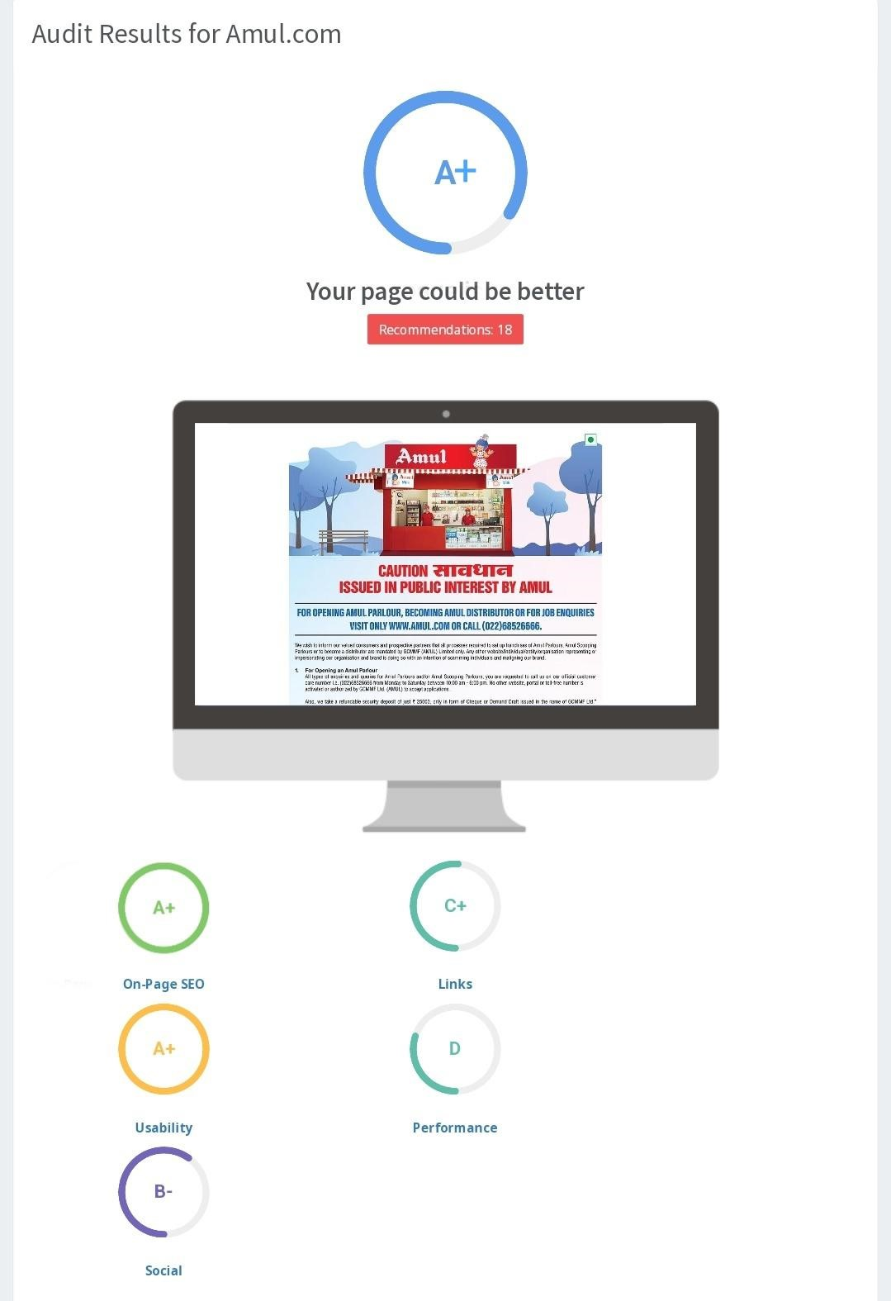
SEO AUDIT
The website has a fair SEO score however it can be improved in certain aspects such as link building & Usability.

Slide 25
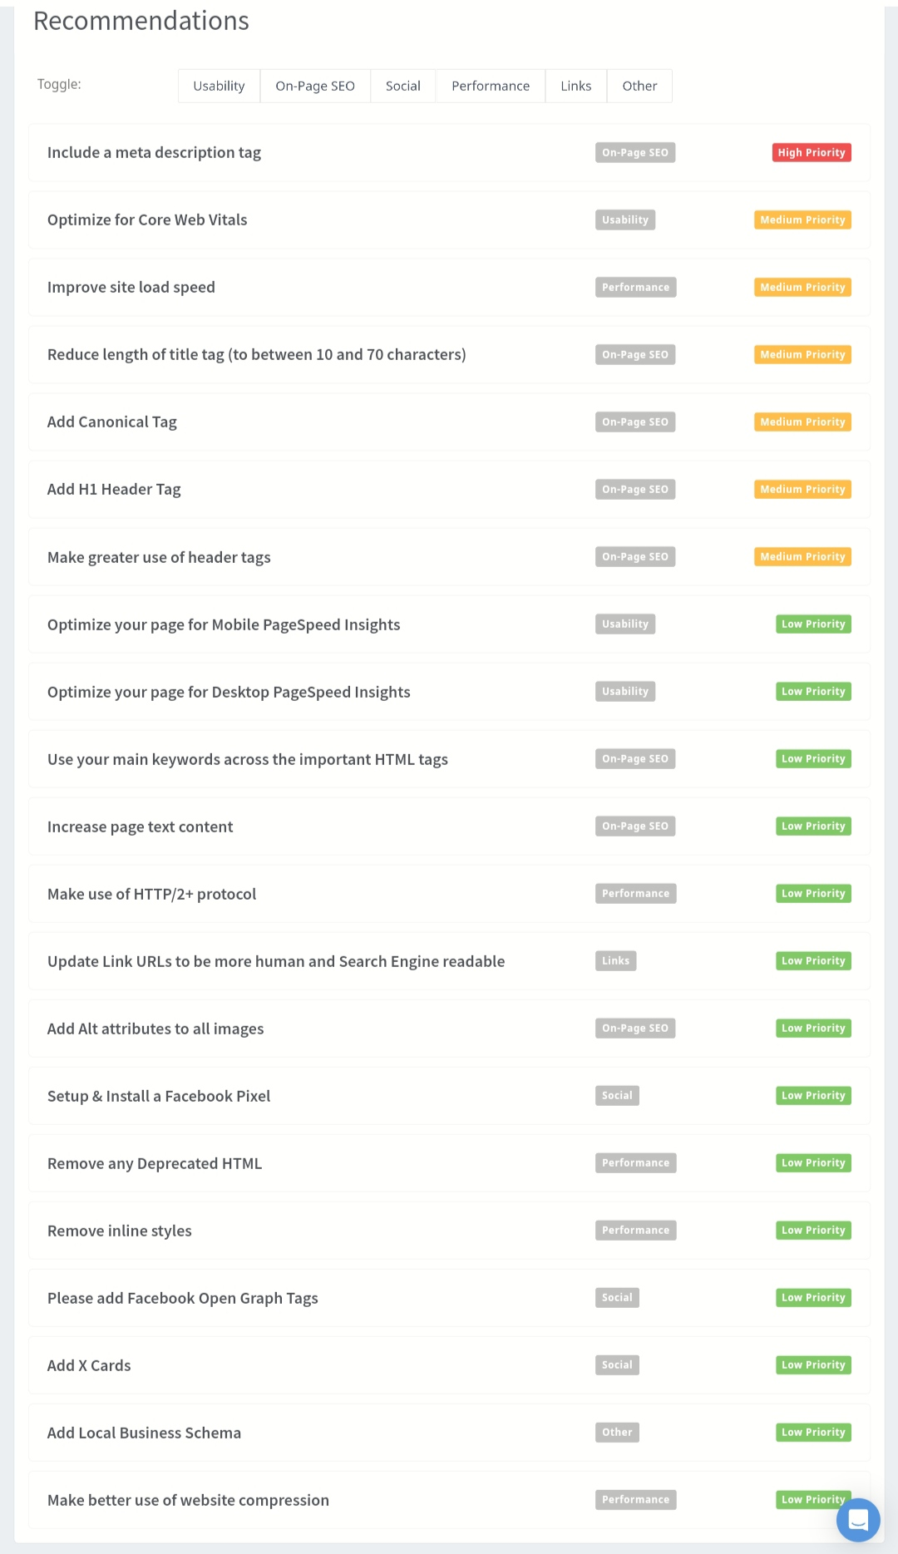
SEO AUDIT
Here are some points of how the website can
improve its SEO
● Optimise images & other assets by
compressing them
● Remove duplicate H1 Tags
● Start with off page activities such as link
building.

Slide 26
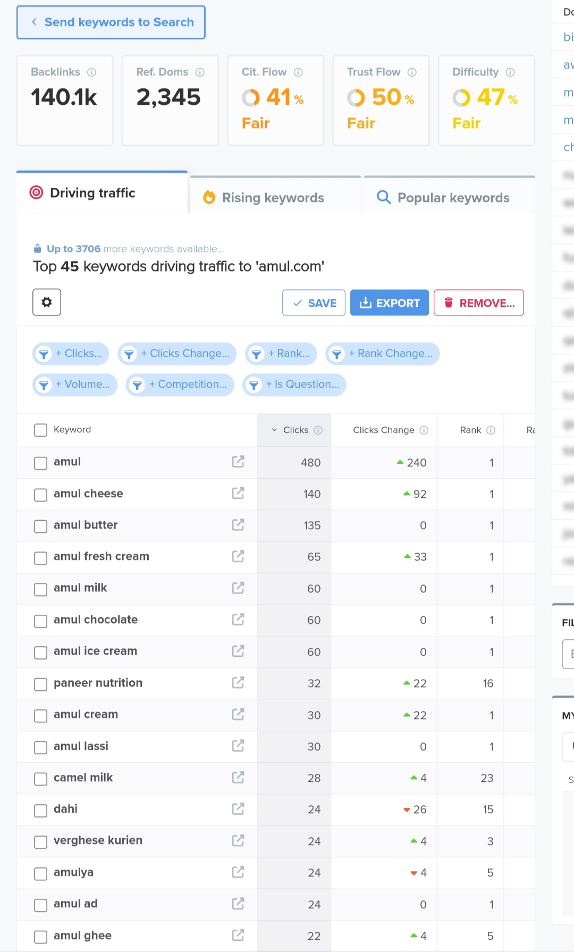
Keyword Research
Keyword Objective: AMUL
Amul
Milk and cream
Ghee and butter
Yogurt and cheese
Ice cream and desserts
We can use these 4 as primary keywords since
they have decent volumes and are relevant to
the brands products.

Slide 27
On Page Optimisation
Focus Key (Keyword): Amul dairy products
Meta Title: Amul Dairy
Products:Quality Milk, Cheese, Butter & More | Amul India
Meta Description: Discover a wide range of high-quality dairy products from Amul. From fresh milk to delicious cheese and creamy butter, Amul offers nutritious options for your family. Explore our dairy range now

Slide 28
On Page Optimization (Content Optimization)
Introduction:
Provide a brief overview of Amul as a leading dairy brand, highlighting its history, mission, and commitment to quality and sustainability.Include key messaging about Amul's diverse range of dairy products and their importance in promoting health and nutrition.Use engaging language to capture the audience's attention and encourage them to explore further
Section 1: About Amul:Expand on the introduction by delving deeper into Amul's background, including its origins, cooperative model, and significant milestones.Highlight Amul's cooperative structure, emphasizing its support for local dairy farmers and its impact on rural livelihoods.Showcase Amul's core values, such as quality, affordability, and sustainability, and how they are reflected in its products and operations.
Section 2: Product Range:Provide an overview of Amul's extensive product portfolio, including milk, cheese, butter, yogurt, ice cream, and more.Detail the nutritional benefits and versatility of each product category, highlighting their importance in daily nutrition and culinary applications.Include images or graphics of Amul's products to visually showcase their variety and appeal.
Section 3: Quality Assurance:Outline Amul's rigorous quality control measures and standards to ensure the freshness, purity, and safety of its dairy products.Highlight certifications, awards, or accreditations that demonstrate Amul's commitment to quality and excellence.

Slide 29
Document the challenges faced during the research and analysis phase, as well as the key insights gained from the keyword research process.
Challenges:
Data Accessibility: Gathering comprehensive data about Amul's competitors, market trends, and consumer preferences proved challenging due to limited accessibility to relevant sources. Some information may not have been publicly available or easily accessible, making it difficult to conduct thorough research and analysis.
Competitive Landscape Complexity: Analyzing the competitive landscape for Amul, including other dairy brands and related industries, posed a challenge due to the complexity of the market. Understanding the strategies, positioning, and market share of competitors required thorough research and data
Key Insights:
Consumer Preferences and Trends: Despite data accessibility challenges, keyword research provided valuable insights into consumer preferences, trends, and behaviors related to dairy products. Analyzing search queries and keyword trends helped identify popular topics, interests, and questions among Amul's target audience, informing content creation and marketing strategies.
Product Optimization Opportunities: Keyword research revealed opportunities for optimizing Amul's product descriptions, meta tags, and website content to improve search engine visibility and attract organic traffic. Identifying high-volume, low-competition keywords related to Amul's dairy products allowed for targeted optimization efforts to enhance online presence and reach.

Slide 30
Part 3: Content Ideas and Marketing Strategies
Content Idea Generation & Strategy: Create a content calendar for the remaining month of April
by brainstorming content themes, exploring various formats like blog posts, videos, infographics, podcasts, and interactive quizzes, and scheduling publication dates mainly on Facebook & Instagram. And include the strategy, aim and the idea behind only for the post and story mentioned in the calendar.

Slide 31
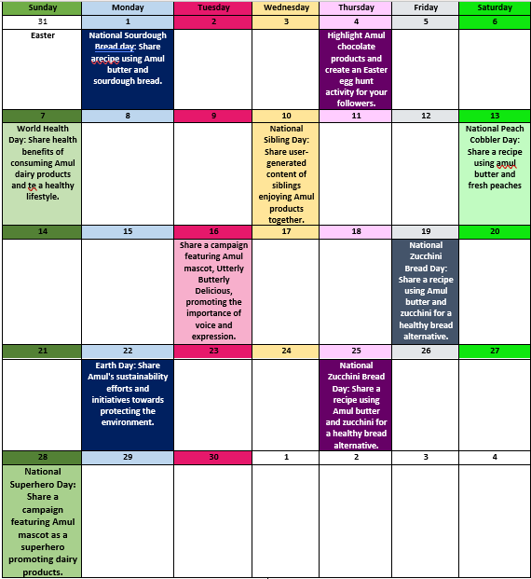
Content Calendar for the month of April
"Every month is a celebration with Amul! Indulge in a year full of dairy delights, creamy goodness, and chocolate heaven. Let each day be a reminder to taste the difference and share the love with Amul. #AmulCalendar #DairyDelights”
April 2024

Slide 32
Strategy, Aim and the Idea behind this story
Strategy: The strategy behind this story is to leverage content marketing to promote Amul's dairy products by providing valuable and engaging content to consumers. By focusing on education, inspiration, and storytelling, the aim is to enhance brand awareness, showcase product benefits, and foster a deeper connection with the target audience.
Aim: The aim of this story is to position Amul as a trusted source of high-quality dairy products while highlighting its commitment to health, nutrition, and sustainability. Through compelling content, the goal is to educate consumers about the benefits of consuming dairy, inspire them to incorporate Amul products into their daily lives, and ultimately drive sales and brand loyalty.
Idea: The idea behind this story is to create content that resonates with Amul's target audience by addressing their interests, needs, and aspirations. This includes sharing informative articles, recipe videos, and behind-the-scenes glimpses of Amul's farm-to-table journey to showcase the brand's heritage, quality, and authenticity. By leveraging storytelling and visual storytelling techniques, the goal is to captivate and engage consumers while reinforcing Amul's brand values and positioning in the market.

Slide 33
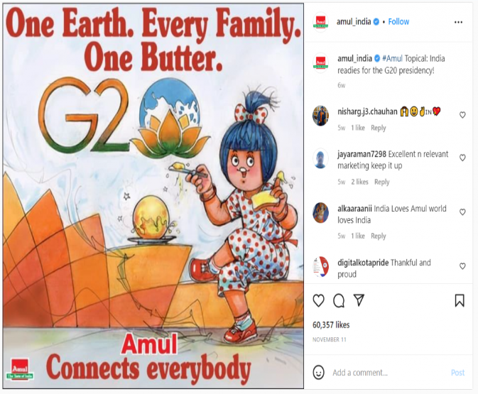
Strategy, Aim and the Idea behind this post
Strategy:
The strategy behind this post is to leverage social media to promote Amul's dairy products by creating engaging and shareable content. By tapping into the popularity of social media platforms, the aim is to increase brand visibility, generate buzz, and drive user engagement.
Aim:
The aim of this post is to highlight Amul's products in a creative and visually appealing way, showcasing their versatility and quality. By creating an eye-catching post that resonates with Amul's target audience, the goal is to spark interest, encourage interaction, and ultimately drive traffic to Amul's website or retail outlets.
Idea:
The idea behind this post is to showcase Amul's dairy products in a fun and relatable context that captures the attention of social media users. This could involve creating a visually appealing graphic or video featuring Amul's products in various recipes or culinary creations..

Slide 34
Part 3: Content Ideas and Marketing Strategies
Recipe Videos: Produce high-quality recipe videos featuring Amul's dairy products as key ingredients. Showcase a diverse range of recipes, from classic dishes to innovative creations, catering to different tastes and preferences. Share these videos on social media platforms, website, and YouTube to inspire and engage consumers.
Nutritional Guides: Develop informative and visually appealing nutritional guides highlighting the health benefits of consuming Amul's dairy products. Include tips, facts, and recipe suggestions to educate consumers about the nutritional value of dairy and promote Amul as a trusted source of wholesome and nutritious foods.
Farm-to-Table Series: Create a farm-to-table series that takes viewers on a journey behind the scenes of Amul's dairy farms and production facilities. Share stories of the farmers, artisans, and experts behind Amul’s products, emphasizing the brand's commitment to quality, sustainability, and supporting local communities.
Educational Webinars and Workshops: Host educational webinars and workshops focused on topics related to dairy nutrition, cooking techniques, and culinary trends. Invite industry experts, nutritionists, and chefs to share insights and tips, positioning Amul as a trusted authority in the dairy industry and providing value to
consumers.
Loyalty Programs and Rewards: Implement loyalty programs and rewards for loyal customers to incentivize repeat purchases and brand loyalty. Offer exclusive discounts, freebies, and rewards points for purchases of Amul's products, encouraging customer retention and fostering long-term relationships with consumers.

Slide 35
Part 4: Content Creation and Curation
Post Creation:
● Select Content Categories: Come up with three different content formats relevant to the
chosen topic or industry. Research and Brainstorm: Research trending topics, industry news,or audience interests within each category. Brainstorm ideas for social media posts that align with each category. Write complete content/caption along with the CTAs.
Format 1
Format 2
Format 3
For Amul, content ideas and marketing strategies could include creating engaging recipe videos showcasing the versatility of their dairy products, collaborating with influencers to reach new audiences, and launching seasonal campaigns tied to holidays and festivals. Educational content about dairy nutrition and cooking tips can also position Amul as a trusted source of information.

Slide 36
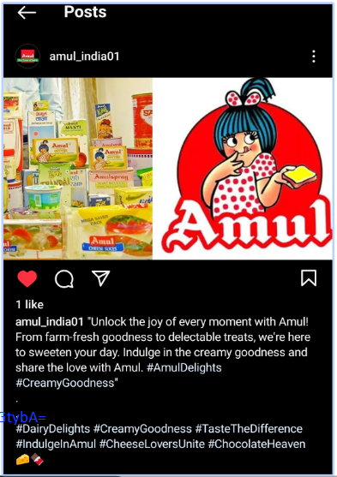
Format 1: Static post on amul brand
Caption:
"Say cheese to pure indulgence with Amul! 🧀✨ From creamy cheeses to velvety chocolates, we've got your cravings covered. Dive into a world of flavor and quality that's been delighting generations. Taste the difference with Amul today! #PureIndulgence #AmulLove 🥛🍫”
Hastags: #PureIndulgence #AmulLove 🥛🍫#DairyDelights #CreamyGoodness #TasteTheDifference #IndulgeInAmul #CheeseLoversUnite #ChocolateHeaven 🧀🍫#DairyDelights #CreamyGoodness #TasteTheDifference #IndulgeInAmul #CheeseLoversUnite #ChocolateHeaven 🧀🍫 Post link:
https://www.instagram.com/p/C58Ar7_yMs8/?igsh=MW14OTByejl0eGtybA==

Slide 37
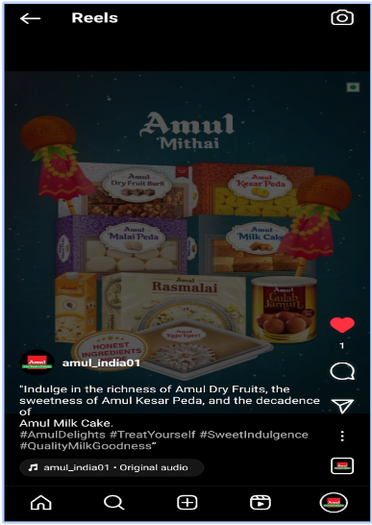
Format 2 - Reel Post on Amul Mitai
Caption:
"Indulge in the richness of Amul Dry Fruits, the sweetness of Amul Kesar Peda, and the decadence of
Hastags:
Amul Milk Cake. #AmulDelights #TreatYourself #SweetIndulgence #QualityMilkGoodness”

Slide 38
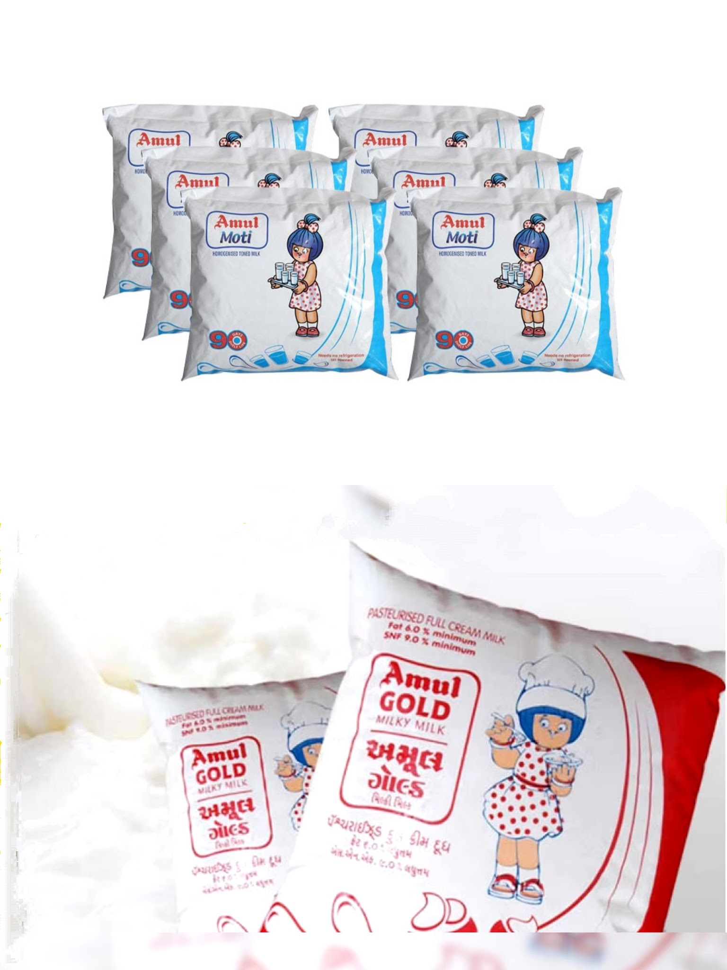
Format 3 - Carousel Post on Amul Milk And curd
Caption:
"Indulge in the goodness of Amul milk and curd! From creamy smoothness to probiotic richness
Hastags:
#AmulDelights #PureGoodness #HealthyChoices #DairyDelights #CurdLovers #MilkMagic 🥛✨”

Slide 39
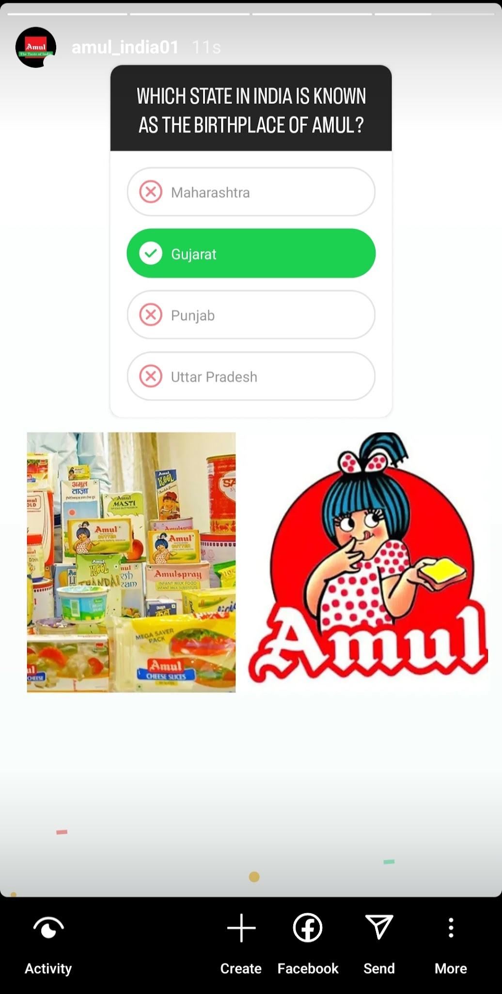
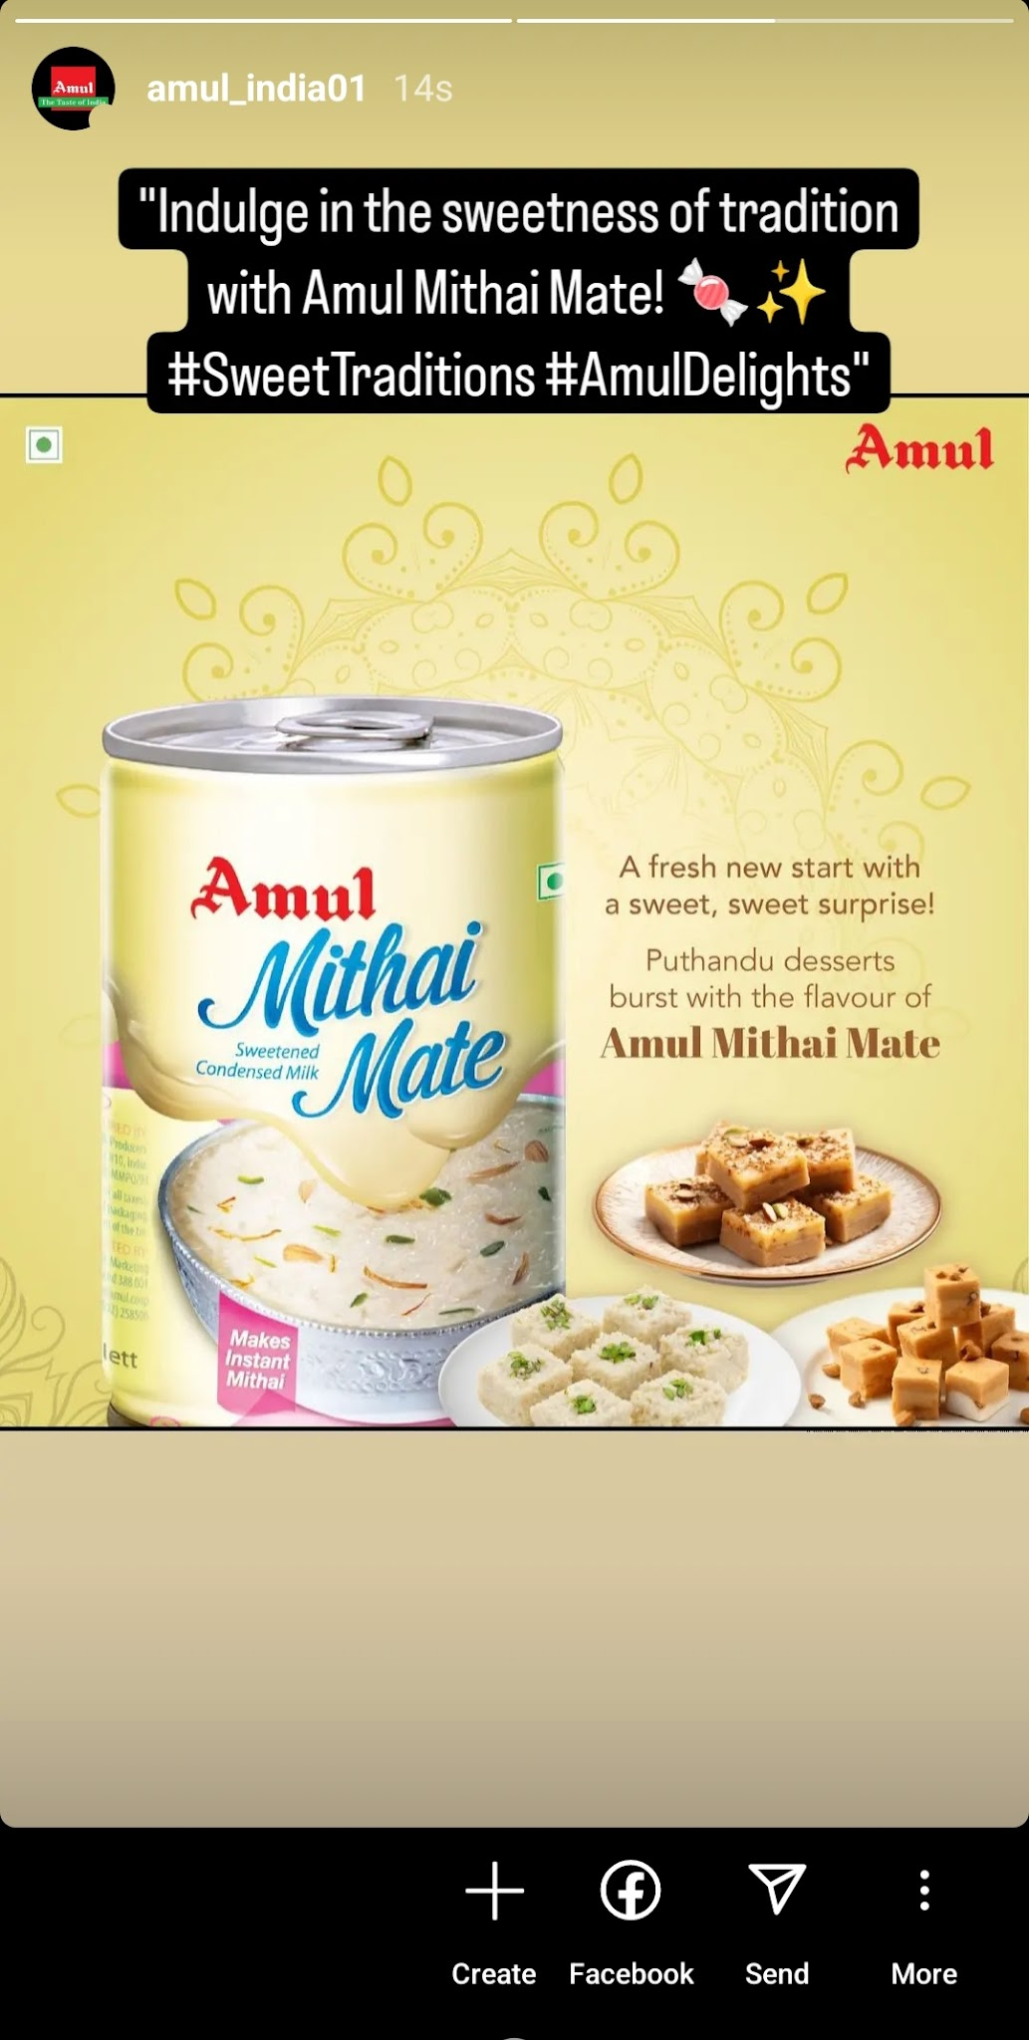
Part 4: Content Creation and Curation Instagram Story
Screenshots of Story.
https://www.instagram.com/amul_india01?igsh=YmpiYmNxaGh6N2kx

Slide 40
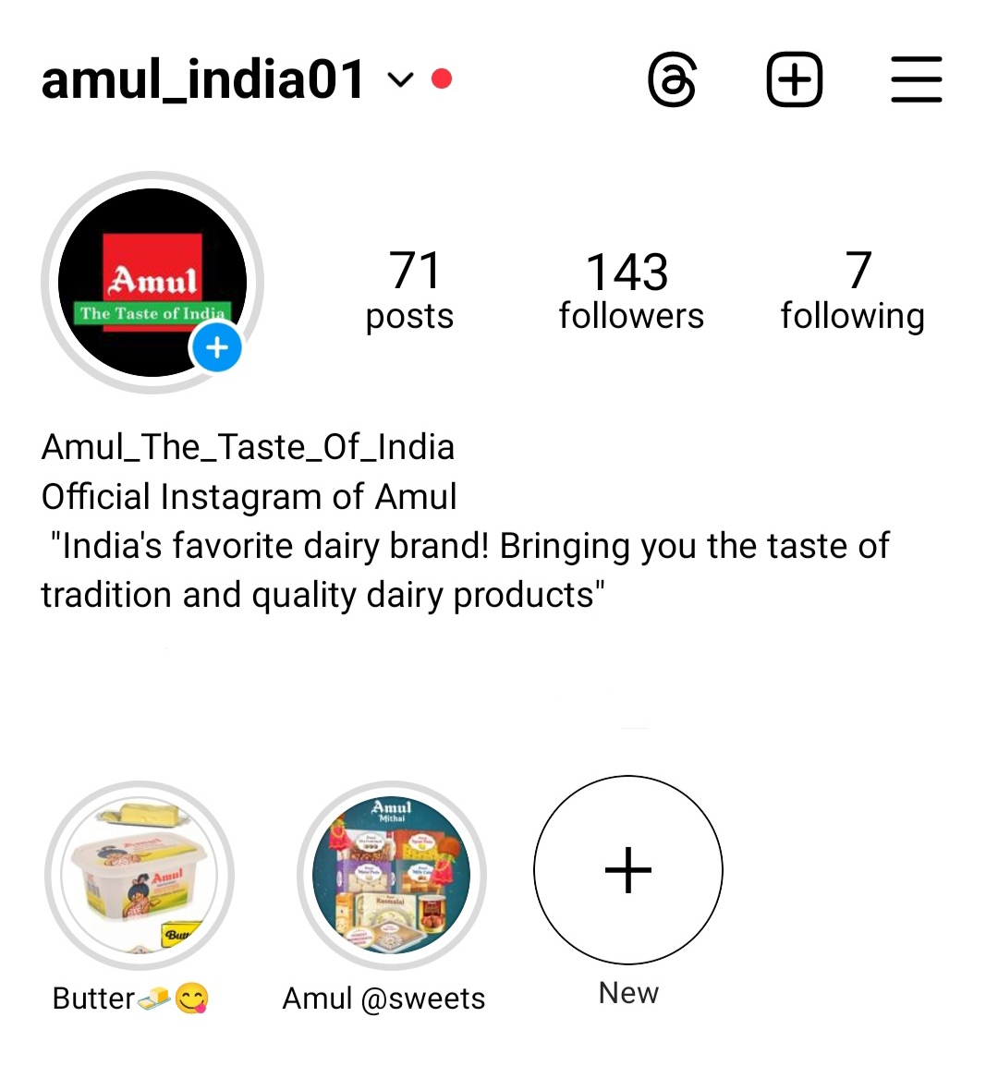
Highlights for Story.
https://www.instagram.com/amul_india01?igsh=YmpiYmNxaGh6N2kx

Slide 41
